Slide 1
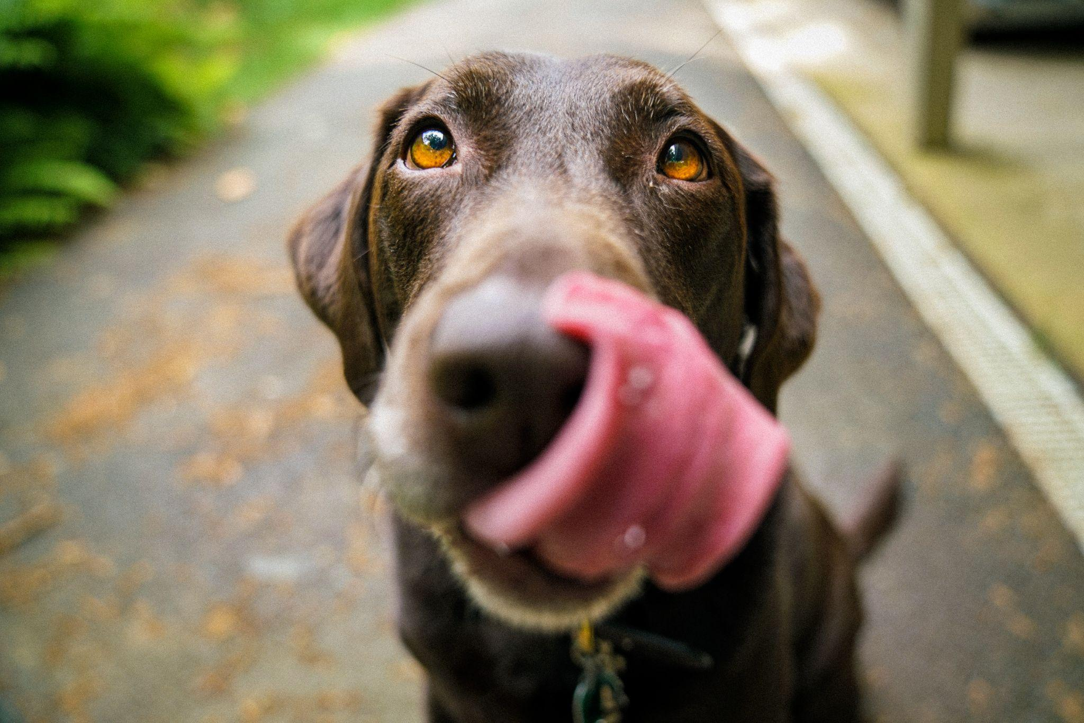
Dog Diet

Slide 2
ToC Project Brief
Background :
Project overview
Goals
Objectives
Target audience
Requirements
Competition
Opportunity
SWOT
MOSCOW

Slide 3
Background
NYC is filled with dogs and most of the owners are unaware of the dietary requirement for their breed. Dogs have different dietary requirements based on their breed, size. Dogs of different age, breed, weight requires a different diet which dog owners fail to understand

Slide 4
Project overview
Dog owners have to do some research or reach out to their veteran for these information
To create an informative app where the users can get access to their dog’s dietary plan

Slide 5
Goals
To create an app which will provide a dietary plan for the dog according to their breed, weight and age.

Slide 6
Objectives
-make a dietary plan for the dog
- the portion of the dog for food
- profile of the dog and breed information

Slide 7
Target audience
Dog owners
Dog sitters
According to NYC Economic Development Corporation, there are roughly 1.1 million pets in the city - 600,000 dogs . That amounts to about one pet in every three homes

Slide 8
Requirements
Technical Requirements-- smartphones , laptop ,
-operating system IOS, Android .
Functional Requirements - the app will have filters such as breed, age and weight
Non- functional requirements
The app should be able to handle 2 million users without performance issue
The dog owner needs to make a profile with their name and credentials to access the service

Slide 9
Competition
Barfastic -BARF Diet for Dogs
Founded- december 2 , 2020
Only available on Andriod
The Fat Dog Diet
- focuses more on losing weight

Slide 10
Opportunity
Lot of the dog diet app are focused more on losing weight rather than providing a daily dietary plan
Most of the apps can only run on android

Slide 11
SWOT
STRENGTH- the platform enables users to access dietary plan
WEAKNESS- the app won’t give extensive day to day dietary pan, but a general one. And is focused on dogs only
OPPORTUNITIES- The app will give out homemade recipes
THREATS- some features can be similar to existing app.Features can also be copied by new or existing app

Slide 12
WoSCoW
MUST HAVE-Dietary plan, recipe and nutrition information
SHOULD HAVE -contact information , profile can be only created on dog’s name
COULD HAVE -Blogs, any dog related news , information
WON’T HAVE -Paid subscription , or membership fees

Slide 13
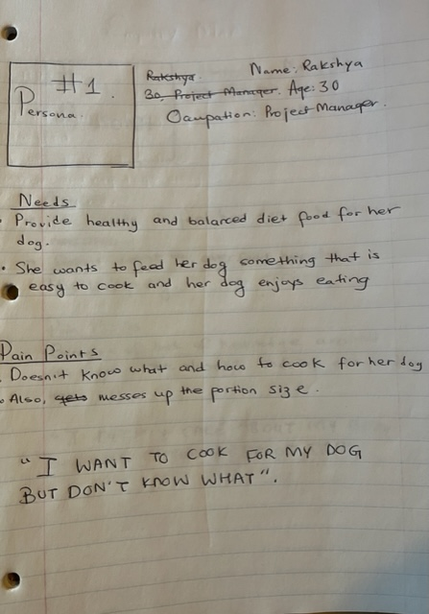

Slide 14
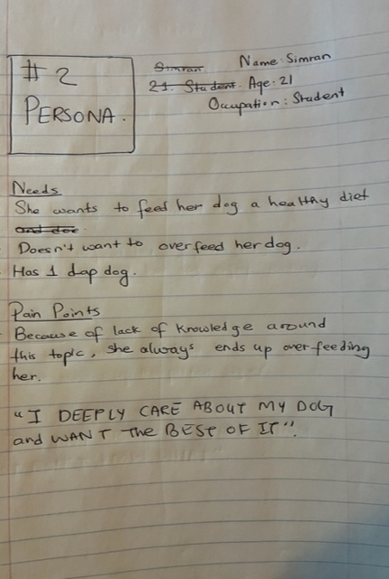

Slide 15
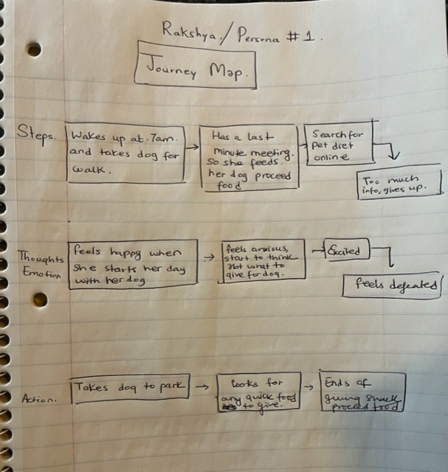

Slide 16
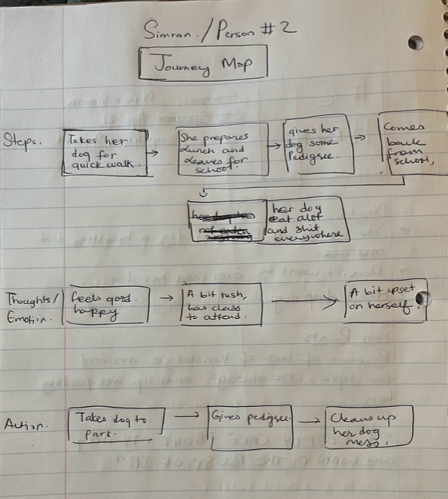

Slide 17
wireframes
Following low- fidelity wireframe showcases the initial ideas and prototype of the app

Slide 18
